Slide 1

2026
TECH-SHOPPEN.DK
CRO Audit & Opportunity Report
GA4 Analysis
Sequential Funnel
Heuristic Audit
Voice of Customer
Competitors
tech-shoppen.dk · Kids tech & home gadgets, Shopify, Denmark · Audit date 15 Jul 2026
GA4 property 375103003 (90-day pull, 16 Apr to 15 Jul 2026, + sequential funnel), PageSpeed, 404 Trustpilot reviews, 3 verified competitors.
Prepared by EcomHouse
ECOMHOUSE ©ALL RIGHTS RESERVED
00

Slide 2
2026
METHODOLOGY
How this audit was built
Every finding is grounded in GA4 data, live page behaviour, or the customer's own words. Absolute GA4 numbers are directional (a third of purchases arrive with no source), but the step to step ratios drive every priority.
// 01
// 02
// 03
GA4 evidence
Live page & speed
VOC + competitors
90-day pull + sequential funnel from property 375103003: sessions, revenue, device split, per-product landing performance, true View to Purchase funnel.
Full walk of homepage, collection, KidsBuddy PDP and cart on desktop and mobile, plus Google PageSpeed and a live tag audit (GTM, GA4, Google Ads, Meta verified).
404 Trustpilot reviews (3.9/5) theme coded with verbatim Danish quotes, plus 3 verified competitors: xplora.dk, kidsbuddy.dk and techbutik.dk.
One gap worth naming: no behavioral analytics tool (Microsoft Clarity or Hotjar) is installed, so there are no session recordings behind this audit. Clarity is free; installing it is itself a recommendation of this deck.
ECOMHOUSE ©ALL RIGHTS RESERVED
01

Slide 3
2026
EXECUTIVE SUMMARY
Where the money is leaking
90-day GA4: 49,156 sessions, 1,496 orders, 945,697 DKK revenue, 3.04% conversion, 632 DKK AOV. A healthy top line with six specific leaks under it.
01
92.8% drop from View Product to Add to Cart
02
A third of all orders have no traffic source
27,696 users view a product, only 1,994 add to cart. Concentrated on the long-tail PDPs, not KidsBuddy.
"(not set)" holds 498 of 1,496 purchases and 296,226 DKK (31% of revenue) at a reported 100% bounce.
7.2% VIEW TO ATC
498 ORDERS UNATTRIBUTED
03
Mobile wins the cart, then loses the checkout
04
36% of traffic produces 9% of revenue
Mobile is 89% of sessions and adds to cart better than desktop (7.4% vs 5.3%), but only 45.3% of mobile checkouts complete vs 64.9%.
Facebook paid (11,335 sessions, 0.86% CVR) and MakeInfluence (6,277 sessions, 0.64% CVR) bring 17,612 sessions for 86,671 DKK.
45.3% VS 64.9% CHECKOUT
FB 6.3 VS GOOGLE 19.5 DKK/SESSION
05
KidsBuddy is 56% of revenue, its #1 objection unanswered
06
Returning visitors convert 3x, almost none come back
The PDP converts 2.93%, but 7 of the last 39 Trustpilot reviews attack GPS accuracy and the app, and the page says nothing about either.
Returning sessions convert at 7.02% vs 2.37% for new, yet Klaviyo email drives just 1,293 sessions in 90 days.
528,276 DKK ON ONE PDP
7.02% VS 2.37% CVR
ECOMHOUSE ©ALL RIGHTS RESERVED
02

Slide 4
2026
00
QUANTITATIVE ANALYSIS
The numbers
GA4 property 375103003. 90-day totals (16 Apr to 15 Jul 2026) and a sequential View to Purchase funnel.
ECOMHOUSE ©ALL RIGHTS RESERVED
03

Slide 5
2026
BASELINE
Where tech-shoppen.dk stands today
Last 90 days, GA4 property 375103003. Treat absolute numbers as directional anchors.
945,697 DKK
49,156
1,496
3.04%
632 DKK
REVENUE (90D)
SESSIONS
ORDERS
CONVERSION RATE
AVG ORDER VALUE
44,083
19.24 DKK
17.7%
96%
89%
USERS
REVENUE / SESSION
ENGAGEMENT RATE
SESSIONS FROM DENMARK
TRAFFIC ON MOBILE
A 3.04% blended conversion rate is a real strength for a store this young. The caution flags are the 17.7% engagement rate (typical of cold paid PDP traffic) and how concentrated everything is: one product, one country, one device class.
ECOMHOUSE ©ALL RIGHTS RESERVED
04

Slide 6
2026
FUNNEL DECOMPOSITION
Two steps are eating the funnel
GA4 sequential funnel (Funnel API, unique users per step, same-session journeys; full 90-day total is 1,496 orders). The leaks: add to cart, and the checkout itself.
Session start
29,566
View product
27,696 · 93.7%
Add to cart
1,994 · 7.2%
Begin checkout
1,029 · 51.6%
Purchase
481 · 46.7%
92.8% of product viewers never add to cart, and of those who start a checkout, more than half abandon it. 93.7% of sessions reach a product page (ads land straight on PDPs), so the whole game is trust at the buy box and friction in the checkout.
ECOMHOUSE ©ALL RIGHTS RESERVED
05

Slide 7
2026
DEVICE SPLIT
Mobile fills the cart. Checkout empties it.
89% of sessions are mobile. The funnel shows mobile shoppers are MORE willing to add to cart than desktop (7.4% vs 5.3%). Then the mobile checkout gives half of them back.
MOBILE · 89% OF SESSIONS
DESKTOP · 11% OF SESSIONS
45.3%
64.9%
vs
checkout completion 43,862 sessions · 1,276 orders · 801,256 DKK · 2.91% CVR
checkout completion 5,363 sessions · 214 orders · 141,696 DKK · 3.99% CVR
Est. opportunity: lifting mobile checkout completion from 45.3% to 55% (still 10 points under desktop) is roughly +270 orders per quarter at the 628 DKK mobile AOV, about Est. 170,000 DKK per quarter. The levers sit inside the checkout: payment method order (MobilePay first), shipping cost surprise, express pay before the form.
ECOMHOUSE ©ALL RIGHTS RESERVED
06

Slide 8
2026
TRAFFIC & SPEND
Four paid channels, a 10x efficiency spread
90-day GA4 by source / medium. Revenue per session combines conversion and order value into what one click is worth. Top sources shown; the remainder is long tail.
Source / medium | Sessions | Orders | CVR | Rev / session | Revenue
google / cpc | 14,109 | 414 | 2.93% | 19.5 DKK | 275,505 DKK
facebook / paid | 11,335 | 98 | 0.86% | 6.3 DKK | 71,103 DKK
makeinfluence / influencer | 6,277 | 40 | 0.64% | 2.5 DKK | 15,568 DKK
partnerads / affiliate | 6,073 | 262 | 4.31% | 28.6 DKK | 173,600 DKK
(not set) | 4,386 | 498 | n/a | n/a | 296,226 DKK
(direct) / (none) | 3,023 | 77 | 2.55% | 16.5 DKK | 49,782 DKK
Klaviyo / email | 1,293 | 43 | 3.33% | 18.7 DKK | 24,192 DKK
google / organic | 1,138 | 25 | 2.20% | 13.6 DKK | 15,444 DKK
An affiliate click via Partner-ads is worth 11x an influencer click (28.6 vs 2.5 DKK) and Google CPC is worth 3x Facebook. Facebook and MakeInfluence together are 36% of sessions for 9% of revenue. And the "(not set)" row means some of this table's credit is misassigned: next slide.
ECOMHOUSE ©ALL RIGHTS RESERVED
07

Slide 9
2026
ATTRIBUTION
A third of your orders are invisible to marketing
The single strangest number in the account, and the most fixable. 498 orders (296,226 DKK) sit in a channel GA4 calls "(not set)", reported with 100% bounce and zero engagement.
"(NOT SET)" CHANNEL · 90 DAYS
"(NOT SET)" LANDING PAGE
498
1,863
+
orders with no traffic source 4,386 sessions · 296,226 DKK · 31% of all revenue 100% bounce, 0 engaged sessions: broken sessions, not real visits
sessions with no landing page 99.5% bounce · 0 purchases attributed the classic signature of tracking broken by consent handling or session loss
What this means in practice: Google and Meta smart bidding, and every "which channel works" decision, run on two thirds of the truth. The fix list is standard and cheap: verify Consent Mode v2 fires before GA4, check first-party cookies survive the checkout domain, enforce UTM tags on every paid, influencer and email link, and add Meta Conversions API server-side. Do this before judging any channel.
ECOMHOUSE ©ALL RIGHTS RESERVED
08

Slide 10
2026
PRODUCT ECONOMICS
One PDP pays for everything. The rest leak.
Landing sessions per product, 90 days. KidsBuddy converts 2.93% cold. The long tail converts at a third to a tenth of that, on the same store.
Landing page | Sessions | Orders | CVR | Revenue | Rev share
KidsBuddy GPS smartwatch | 24,331 | 713 | 2.93% | 528,276 DKK | 55.9%
Bærbar blender | 684 | 34 | 4.97% | 4,710 DKK | 0.5%
Kidsboard magnettavle | 3,553 | 75 | 2.11% | 43,893 DKK | 4.6%
Noomu søvntræner | 1,291 | 25 | 1.94% | 11,354 DKK | 1.2%
Stjernehimmel projektor | 3,548 | 60 | 1.69% | 17,231 DKK | 1.8%
Beamly wifi projektor | 2,806 | 30 | 1.07% | 21,699 DKK | 2.3%
Glimmt løbecykel | 3,080 | 28 | 0.91% | 21,094 DKK | 2.2%
Smart cleaner | 224 | 0 | 0.00% | 0 DKK | 0%
The spread is the opportunity. Glimmt, Beamly and Stjernehimmel receive 9,434 mostly paid sessions at 0.91 to 1.69%. Bringing them to Kidsboard's 2.11% is Est. +80 orders per quarter (~50,000 DKK). KidsBuddy's own lever is attach: the 299 DKK screen guarantee converts 7.58% for those who find it as a separate product.
ECOMHOUSE ©ALL RIGHTS RESERVED
09

Slide 11
2026
RETENTION & EMAIL
The 3x audience nobody is inviting back
90-day GA4, new vs returning. A gadget store for parents has natural repeat purchases, and returning visitors already behave like fans.
NEW VISITORS · 85% OF SESSIONS
RETURNING · 15% OF SESSIONS
2.37%
7.02%
vs
41,374 sessions · 979 orders 590,220 DKK · 86.6% bounce
7,348 sessions · 516 orders 355,177 DKK · 57.7% bounce
Klaviyo converts well (3.33% CVR, 18.7 DKK/session) but drove only 1,293 sessions in 90 days. Post-purchase flows (SIM reminders, accessory cross-sell, the guarantee offer inside its 14-day window), browse abandon, and one weekly campaign are the cheapest sessions this store can buy. Caveat from the reviews: fix support reply times first, or email volume amplifies the frustration.
ECOMHOUSE ©ALL RIGHTS RESERVED
10

Slide 12
2026
01
FOUNDATION
Site performance
A hygiene check, not the headline. Shopify stores routinely score low on synthetic mobile tests. One number still stands out.
ECOMHOUSE ©ALL RIGHTS RESERVED
11

Slide 13
2026
CORE WEB VITALS
The money page is the heaviest page
Google PageSpeed lab scores, 15 Jul 2026. Synthetic and throttled: most Shopify stores land at 30 to 50 on mobile. Read direction, not absolutes; confirm in CrUX before investing.
Page | Perf (mob) | LCP mob | TBT mob | Speed Index mob | Perf (desk) | LCP desk
Homepage | 40 | 6.6s | 1,090ms | 7.1s | 60 | 1.6s
PDP (KidsBuddy) | 28 | 9.4s | 2,000ms | 13.5s | 52 | 1.8s
How to read this: the homepage sits in the normal Shopify band. The KidsBuddy PDP does not: a 9.4s lab LCP and 13.5s Speed Index on the page that receives 24,331 sessions (49% of all traffic), on a store that is 89% mobile. The practical step is small: compress the PDP image stack and the 11 badge logos, audit installed apps, defer third-party scripts, then verify in CrUX. Hygiene task, worth doing because of where the weight sits.
ECOMHOUSE ©ALL RIGHTS RESERVED
12

Slide 14
2026
02
PAGE BY PAGE
The conversion walk
Why 92.8% of viewers do not add to cart, and why half of mobile checkouts die. Every claim verified against a captured screenshot.
ECOMHOUSE ©ALL RIGHTS RESERVED
13

Slide 15
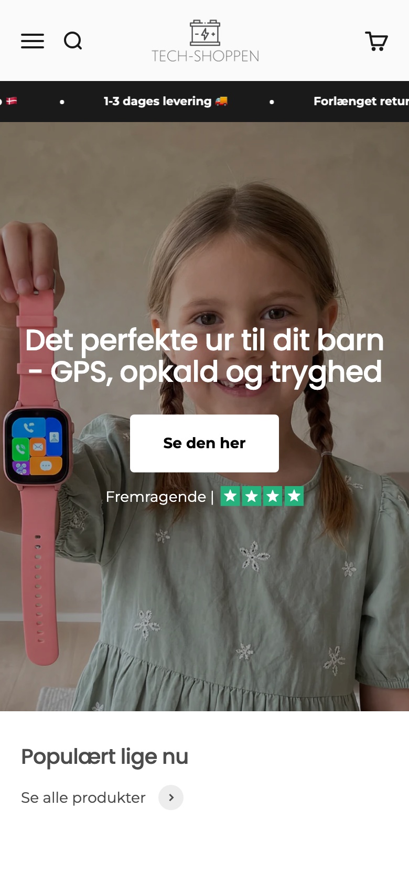
2026
HOMEPAGE
A strong hero, undercut by its own popup
Homepage landings convert at 2.08% with a 57% bounce, the healthiest engagement on the site. It is also only 6% of landings.
What we observed
What to do
• Real lifestyle hero (a child holding the watch) with a benefit headline. Genuinely good.
• A Klaviyo popup fires after ~5-7 seconds and covers the entire mobile fold, on every fresh page load.
• The hero badge says "Fremragende" with green stars. The live Trustpilot score is 3.9 ("God").
• Hero CTA is a vague "Se den her", and the slideshow rotates the message away.
• Navigation is flat: no category entry points anywhere.
1. Delay the popup to exit intent or 30s+, never over a PDP buy box.
2. Replace "Fremragende" with a true, checkable number.
3. Make the CTA concrete: "Se KidsBuddy, fra 749 kr".
4. Add 3-4 category tiles above "Populært lige nu".
5. Keep the lifestyle hero. It is the best asset on the site.
LIVE, MOBILE · 15 JUL 2026
The homepage is not the problem, it is the proof: when visitors land with story and context, bounce halves. The task is to bring that context to the PDPs, where 84% of landings arrive.
ECOMHOUSE ©ALL RIGHTS RESERVED
14

Slide 16
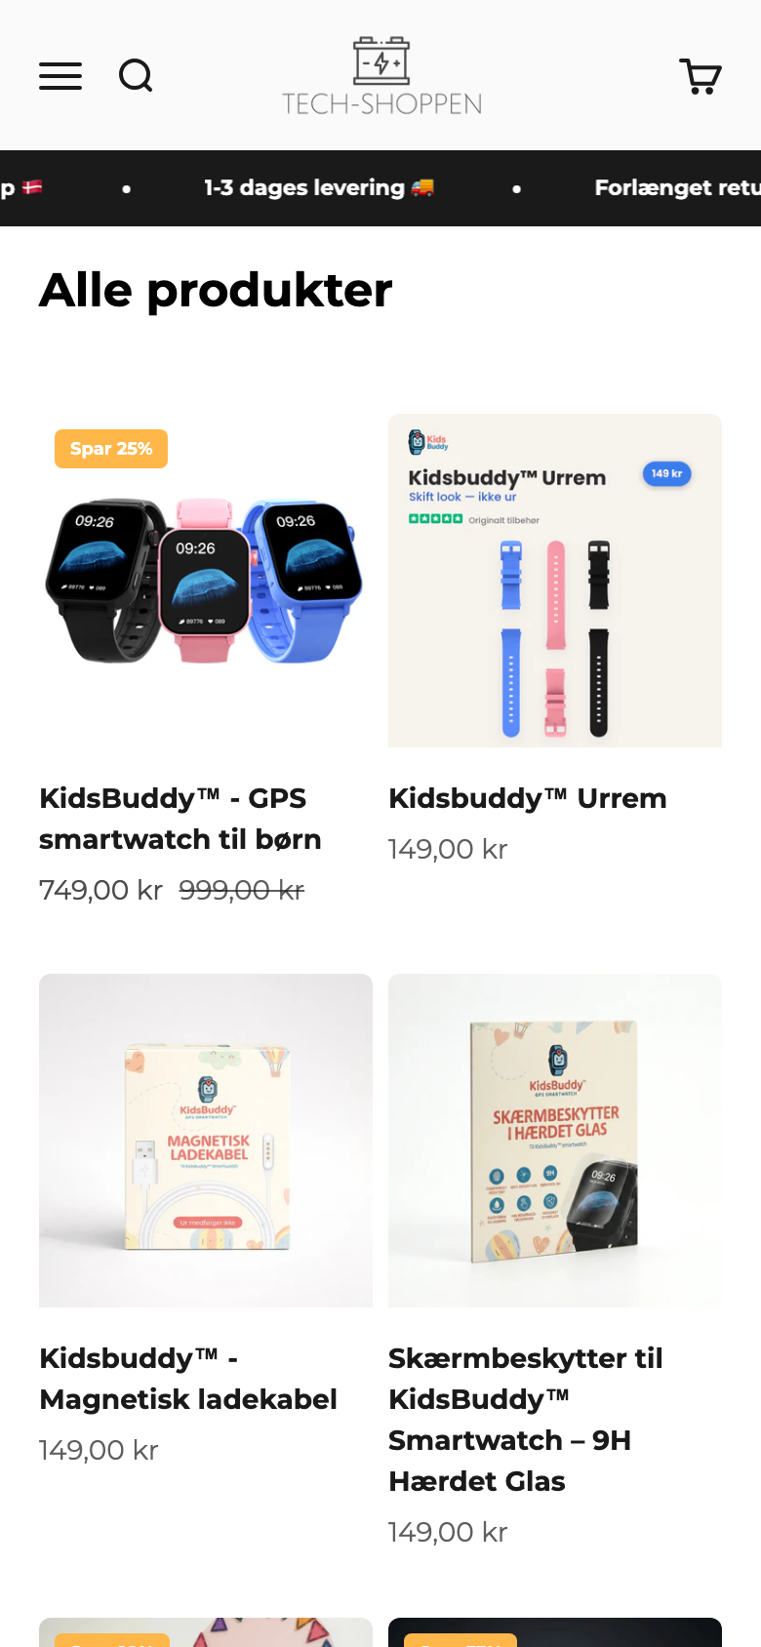
2026
COLLECTION / PLP
One flat list, no proof, no paths
/collections/produkter converts landings at 4.07%, second best on the site, but receives only 565 landing sessions in 90 days.
What we observed
What to do
• 34 products in one flat grid: watches, projectors, blenders and accessories side by side. Only price and stock filters.
• No review stars on any product card.
• Discount badges ("Spar 25%") + "Vejledende udsalgspris" anchors on most cards, a pattern shoppers associate with dropship stores.
• Clean 2-column mobile grid, prices visible. The basics are right.
1. Split into 3-4 real collections and link them from nav + homepage tiles.
2. Show Loox stars + counts on cards for products with reviews.
3. Add a "KidsBuddy tilbehør" collection, linked from the KidsBuddy PDP.
4. Reserve strikethrough anchors for real campaigns to protect price credibility.
LIVE, MOBILE · 15 JUL 2026
Collection and Bestsellers landings convert at 4.07% and 4.76%, roughly double the PDP average. More internal paths into these pages is free conversion.
ECOMHOUSE ©ALL RIGHTS RESERVED
15

Slide 17
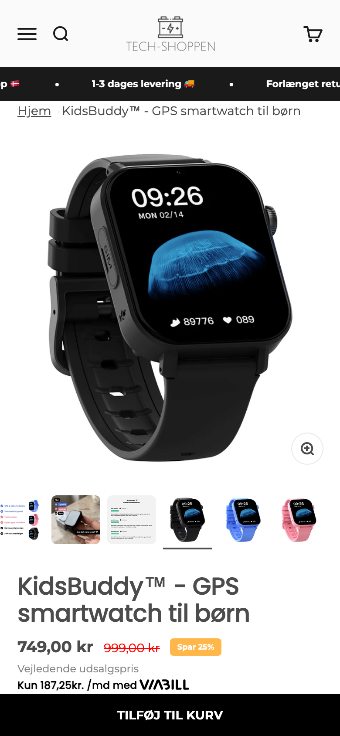
2026
PRODUCT PAGE · KIDSBUDDY
The money page sells hard and reassures little
24,331 landing sessions, 2.93% CVR, 56% of revenue. The buy box stacks offer on offer while the #1 doubt (GPS + app) is answered nowhere.
What we observed
What to do
• Good bones: 6 USP bullets, variants, dispatch countdown, sticky ATC, ViaBill monthly price.
• No review stars or count anywhere in the buy box. The twin kidsbuddy.dk shows "4.8/5 fra 2,200+ forældre".
• The "SuperDeal" bundle is pre-selected: one plain ATC click added 3 items (999 kr).
• Trust is outsourced to 11 affiliate "best in test" badges; GPS and app doubts go unmentioned.
• No video, no real app screenshots, no GPS expectations block.
1. Pin Loox stars + review count directly under the title.
2. Make SuperDeal an explicit opt-in (1 stk 749 kr pre-selected).
3. Add an honest GPS + app block with real SeTracker2 screens.
4. Add a 20-30s demo video (live tracking + a video call).
5. Add the anti-Xplora comparison: 749 kr once vs 1,599 kr + abonnement.
LIVE, MOBILE · 15 JUL 2026
The math of honesty: every element that overstates (a "Fremragende" badge vs a 3.9 Trustpilot, an auto-added bundle) feeds the "dropshipping" suspicion 4 recent reviews voice verbatim. The fixes are additions of proof, not redesigns.
ECOMHOUSE ©ALL RIGHTS RESERVED
16

Slide 18
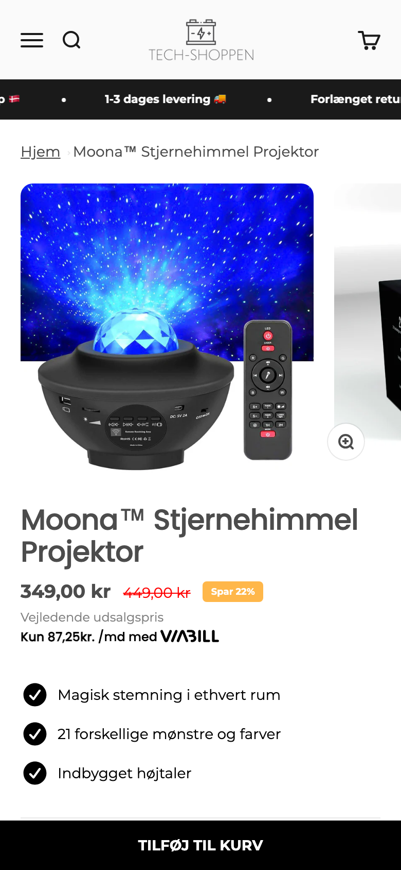
2026
PRODUCT PAGE · LONG TAIL
The same template cannot carry a 349 kr impulse buy
Moona Stjernehimmel: 3,548 sessions, 1.69% CVR. Glimmt: 3,080 at 0.91%. Beamly: 2,806 at 1.07%. Together 9,434 sessions at half the store average.
What we observed
What to do
• Same template as KidsBuddy with the trust stripped out: 3 thin USP bullets, no testimonials, no badges.
• Gallery is a generic supplier render, identical to any marketplace at half the price.
• Same "Spar 22%" anchor pattern, which reads as markup without proof around it.
• The discount popup interrupts these cold paid landings too.
• No cross-sell into the rest of the catalog.
1. Build one stronger long-tail template: lifestyle photo first, stars + count, delivery at ATC.
2. Shoot or source one photo in real context per hero product.
3. Add "Købes ofte sammen" cross-sells between the kids products.
4. Roll the winner template to Glimmt and Beamly, measure against 0.91% / 1.07%.
5. Pause or fix Smart Cleaner (224 sessions, 0 orders).
LIVE, MOBILE · 15 JUL 2026
Visitors spend nearly 4 minutes on the Moona page and still do not buy: interest is there, belief is not. Lifting the three to Kidsboard's 2.11% adds Est. +80 orders per quarter.
ECOMHOUSE ©ALL RIGHTS RESERVED
17

Slide 19
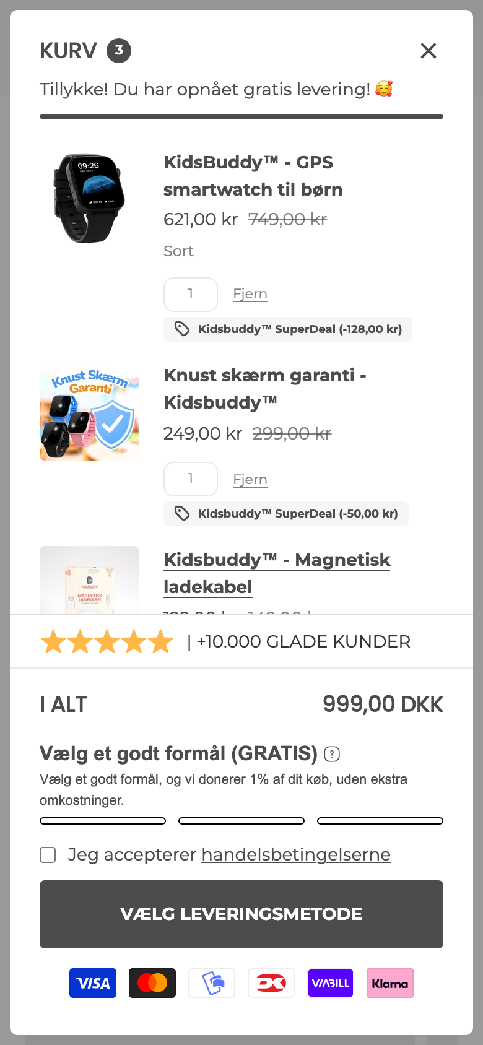
2026
CART DRAWER
A good drawer with two silent leaks
GA4: 51.6% of add-to-carts reach checkout, then only 45.3% of mobile checkouts finish. The drawer has the right furniture; two details work against it.
What we observed
What to do
• Strong furniture: free-shipping progress, a 1% charity selector, payment logos.
• The 749 kr decision became a 999 kr total: the pre-selected SuperDeal added the guarantee and cable without an explicit choice.
• A manual "Jeg accepterer handelsbetingelserne" checkbox gates the checkout button. Unticked, the CTA silently fails.
• The trust bar claims 5 stars; Trustpilot says 3.9.
1. Make the bundle opt-in on the PDP so the drawer total matches the expectation.
2. Remove the terms checkbox from the drawer (keep acceptance at checkout).
3. Swap the 5-star claim for a real, checkable number.
4. Add one-tap express pay (MobilePay / Shop Pay) for the 89% on mobile.
5. Keep the charity selector and the free-shipping bar.
LIVE, MOBILE · 15 JUL 2026
Test order matters here: the checkbox removal and express pay target the 45.3% mobile checkout completion directly and are cheap to run.
ECOMHOUSE ©ALL RIGHTS RESERVED
18

Slide 20
2026
03
IN THEIR OWN WORDS
Voice of customer
404 Trustpilot reviews (3.9/5), theme coded with verbatim Danish quotes.
ECOMHOUSE ©ALL RIGHTS RESERVED
19

Slide 21
2026
VOC · THEME COUNTS
What 404 reviews actually talk about
Trustpilot 3.9/5: 62% five-star, but 22% of all reviews are 1 or 2 stars. Theme coded from the 39 most recent verbatims plus the 1-star filter.
Fast delivery (pos)
9 mentions
Service unresponsive / AI replies
9 mentions
Helpful service (pos)
8 mentions
GPS inaccurate / unusable
7 mentions
Return / refund friction
7 mentions
App quality (Turkish text, ads)
5 mentions
"Cheap China product" perception
4 mentions
The service paradox: customer service is simultaneously the most praised theme and the most attacked one (a broken 48 hour reply promise, gift cards offered instead of refunds). Two reviewers state their refund only arrived after posting the review. That is a policy fix, and it caps every trust signal the site can show.
ECOMHOUSE ©ALL RIGHTS RESERVED
20

Slide 22
2026
VOC · VERBATIM
The customer is writing your copy
All quotes are verbatim Trustpilot reviews for tech-shoppen.dk, captured 15 Jul 2026.
The purchase driver (5★)
The product doubt (1★)
"Det har givet os en kæmpe ro i maven i hverdagen ... det føles bare trygt og smart"
It gives us huge peace of mind. It just feels safe and smart.
→ "Ro i maven" is the hero headline. Parents buy calm, not hardware.
"GPSen er helt hen i vejret ... Appen er virkelig dårlig og med meget dårligt oversat dansk/tyrkisk blanding?! ... Levering var dog super hurtigt!"
GPS way off, app badly translated. Delivery was fast though.
→ The PDP must show real app screens and honest GPS expectations.
The refund wound (1★)
The email irony (2★)
"I erkender problemet men vil nu kun tilbyde et gavekort og ikke pengene retur ... Ifølge købeloven har vi ret til at få pengene retur"
You admit the problem but only offer a gift card, not a refund.
→ Offering gift cards before refunds is manufacturing 1-star reviews.
"De svarer ikke på deres mails, men ironisk nok modtager jeg en frygtelig masse nyheds- og opfølgende mails på min bestilling"
They do not answer support mails but flood me with newsletters.
→ Scale email only after support response times are fixed.
ECOMHOUSE ©ALL RIGHTS RESERVED
21

Slide 23
2026
CUSTOMER INTELLIGENCE
Why they buy. Why they hesitate.
Compiled from 404 Trustpilot reviews, on-site Loox quotes, and the GA4 behaviour of 44,083 users. The left column belongs on the PDP. The right column is what the PDP must answer.
WHY THEY BUY · amplify
WHY THEY HESITATE · answer
• "Ro i maven": GPS + call = peace of mind (hero)
• Fast delivery, praised even in 1-star reviews (buy box)
• 749 kr once vs Xplora at 1,599 kr + 99 kr/month (compare)
• SIM included, no subscription (buy box)
• Danish shop, Danish service, e-mærket (trust bar)
1. "Does the GPS actually work?" (7 reviews say no)
2. App quality: Turkish text, ads, missing features
3. "Cheap China product / dropshipping" suspicion
4. No phone number, slow replies, robotic emails
5. Gift card instead of refund at reklamation
The store already owns everything the left column needs. The right column is why 92.8% of viewers still walk away: when a parent buys safety for 749 kr and "does it actually work" goes unanswered, the default answer is no.
ECOMHOUSE ©ALL RIGHTS RESERVED
22

Slide 24
2026
04
THE FIELD
Competitor benchmark
Three verified Danish competitors: xplora.dk, kidsbuddy.dk and techbutik.dk. Every claim fetched live.
ECOMHOUSE ©ALL RIGHTS RESERVED
23

Slide 25
2026
BENCHMARK MATRIX
Same watch, same price, different proof
kidsbuddy.dk sells the identical watch at the identical 749 kr. The fight is on visible proof and delivery sharpness, and on reframing against Xplora's subscription. Fetched live, 15 Jul 2026.
Dimension | tech-shoppen.dk | xplora.dk | kidsbuddy.dk | techbutik.dk
Price | 749 kr (25% off) | 1,199 to 1,599 kr | 749 kr (identical) | 299 kr
Ongoing cost | SIM incl., 0 kr/mo | 99-109 kr/month app | SIM incl., 0 kr/mo | Pay as you go
Reviews at the offer | Loox, no count shown | 4.67-4.86 stars | 4.8/5, "2,200+ parents" | "2,368+ bedømmelser"
Delivery promise | 1-3 hverdage | Not verified | 1-2 hverdage | 5-8 hverdage
BNPL | ViaBill + Klarna | Not verified | Anyday only | None
Video on PDP | None | Not verified | None | None
Insurance upsell | Separate 299 kr product | Not verified | None | None
The twin problem: a parent googling this watch finds kidsbuddy.dk showing "4.8/5 fra 2,200+ forældre" and 1-2 day delivery for the same 749 kr. Tech-shoppen's counters (Klarna + ViaBill, the screen guarantee, "+10.000 tilfredse kunder") exist but are not deployed at the buy box.
ECOMHOUSE ©ALL RIGHTS RESERVED
24

Slide 26
2026
STEAL THESE
Five patterns worth adopting
Each one observed live on a named competitor (or missing across all of them), mapped to a tech-shoppen gap on the View to ATC step.
// 01
// 02
// 03
Hard review count at the offer
Anti-subscription comparison
Sharper delivery promise
kidsbuddy.dk leads with "4.8/5 fra 2,200+ forældre" next to the price. Pin stars + count to the buy box.
Xplora costs 1,599 kr plus ~1,188 kr/year. A "749 kr once, ingen abonnement" block reframes tech-shoppen as the smart buy.
kidsbuddy.dk promises 1-2 hverdage. Test "Bestil før kl. 14, afsendt i dag" at the ATC.
// 04
// 05
// 06
Insurance as a buy-box toggle
PDP demo video
Own the twin fight
No competitor offers device insurance. Tech-shoppen owns a 299 kr guarantee hidden as a separate product. Uncontested AOV.
None of the three competitors show video. A 20-30s GPS + video-call clip answers the #1 objection in a way no badge can.
The identical watch sells at the same price one search away. Differentiate on Klarna/ViaBill, the guarantee, and e-mærket at the decision point.
Retail channel note: Power and Elgiganten stock Xplora (verified via PriceRunner) but not this watch class at this price. The premium retail shelf anchors the category price high, which is exactly the comparison the PDP should be making.
ECOMHOUSE ©ALL RIGHTS RESERVED
25

Slide 27
2026
05
SEQUENCED FOR IMPACT
90-day roadmap
Fix the data first, then the two funnel leaks, then the moat.
ECOMHOUSE ©ALL RIGHTS RESERVED
26

Slide 28
2026
PRIORITIZED PLAN
90-day roadmap
Ordered by impact over effort. Fix the data first (you cannot steer blind), then the two funnel leaks, then the moat.
PHASE 1 · WEEKS 1-3
PHASE 2 · WEEKS 4-7
PHASE 3 · WEEKS 8-12
Data & free wins
Answer the doubt
Retention & the moat
ATTRIBUTION + TRUST
VIEW TO ATC
COMPOUNDING
→ Fix "(not set)": Consent Mode v2 check, UTM enforcement, Meta CAPI
→ Install Microsoft Clarity (free) ahead of testing
→ Surface review stars + count at the KidsBuddy buy box
→ Attach the 299 kr screen guarantee as a buy-box add-on
→ Sharpen delivery line: "Bestil før kl. 14, afsendt i dag"
→ KidsBuddy PDP: real app screenshots + honest GPS expectations
→ 20-30s demo video (GPS tracking + video call)
→ "749 kr once, ingen abonnement" comparison vs Xplora
→ Mobile checkout pass: MobilePay first, express pay above the form
→ Long-tail PDP template fix (Glimmt, Beamly, Stjernehimmel)
→ Klaviyo flows: post-purchase, browse abandon, guarantee offer
→ Reklamation policy: refund before gift card, always
→ e-mærket badge + Danish service block near ATC
→ PDP speed pass: image stack + app audit, verify in CrUX
→ Collection page: category filters + review stars on cards
Conservative target: the two funnel fixes alone (View to ATC 7.2% to 9.0%, mobile checkout 45.3% to 55%) are worth Est. 250,000 to 400,000 DKK per quarter at the current 632 DKK AOV.
ECOMHOUSE ©ALL RIGHTS RESERVED
27

Slide 29
2026
EXECUTION
Just ship vs A/B test
Some fixes are obviously correct with no downside. Others change the buying experience enough to deserve a measured test against the 3.04% baseline.
JUST SHIP · no downside
A/B TEST · measure it
• Consent / UTM / CAPI attribution repair
• Install Clarity, baseline recordings
• Review stars + count at buy box
• Refund before gift card at reklamation
• PDP image/app weight pass
1. Screen guarantee as buy-box add-on (AOV)
2. GPS expectations + app screens block (View to ATC)
3. Anti-subscription comparison vs Xplora (View to ATC)
4. Demo video in PDP gallery (View to ATC)
5. Mobile checkout: express pay first (checkout CVR)
ECOMHOUSE ©ALL RIGHTS RESERVED
28

Slide 30
2026
SUMMARY SCORECARD
tech-shoppen.dk at a glance
Where the store stands today against the dimensions that decide conversion for kids gadgets, with the evidence behind each.
Dimension | Today | Evidence | Priority
Attribution & data trust | Broken | 498 of 1,496 orders in "(not set)"; 1,863 sessions with no landing page | P1
View to Add-to-Cart | Critical | 92.8% of product viewers never add (GA4 sequential funnel) | P1
Proof at the buy box | Missing | No review count near ATC while the twin shows "2,200+ parents" | P1
Mobile checkout | Leaky | 45.3% completion vs 64.9% desktop, on 89% mobile traffic | P2
KidsBuddy objection handling | Absent | GPS doubts in 7 and app complaints in 5 of 39 recent reviews | P2
AOV mechanics | Half built | 299 kr guarantee sold separately; no explicit bundle choice | P2
Paid efficiency | Uneven | Partner-ads 28.6 DKK/session vs MakeInfluence 2.5 DKK/session | P2
Retention / email | Underused | Returning CVR 7.02% vs 2.37%; Klaviyo = 2.6% of sessions | P3
Delivery & logistics | Strength | Praised in 9+ reviews, even inside 1-star reviews | keep
Blended conversion | Healthy | 3.04% overall, KidsBuddy 2.93% as cold landing | keep
Biggest single lever: Answer the GPS doubt at the buy box, then unbreak the data.
ECOMHOUSE ©ALL RIGHTS RESERVED
29

Slide 31
2026
06
READY TO RUN
A/B test plans
The three highest-priority tests, written to the pre-test brief standard: observation, hypothesis, variant spec, metrics and frozen baselines.
ECOMHOUSE ©ALL RIGHTS RESERVED
30

Slide 32
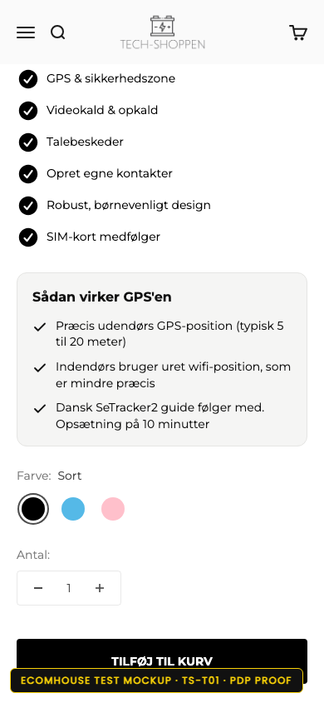
2026
Observation
T01 · PDP · Proof at the buy box
Only 7.2% of product viewers add to cart. The KidsBuddy buy box shows no review stars or count, while kidsbuddy.dk shows "4.8/5 fra 2,200+ forældre" at the same 749 kr. The #1 objection (GPS, 7 mentions; app, 5) is answered nowhere.
Test ID: TS-T01 Status: In planning
A/B TEST
Hypothesis
CHANGES
If we pin the Loox rating + count under the title and add an honest GPS + app expectations block, then add-to-cart rate will rise, because the two doubts that stop a 749 kr parent purchase get answered at the decision point.
1. Loox stars + review count pinned under the title
2. GPS + app expectations block with real app screens
3. e-mærket + "ingen abonnement" line near the ATC
What we are testing
• Loox stars + count pinned under the product title
• "Sådan virker GPS'en" block: real SeTracker2 screens
• e-mærket + "749 kr once, ingen abonnement" near the ATC
Key metrics
1. Add-to-cart rate (PDP)
2. PDP conversion rate
3. Return / reklamation rate (guardrail)
Duration
Device
CONTROL · LIVE PDP
VARIANT · BUILT DESIGN
3 to 4 weeks
All devices
Live buy box: price, ViaBill, sticky ATC. No stars, no count.
HTML mockup on the live theme. Change spec in the left rail.
Baseline
URL
2.93% CVR · 24,331 sessions/q
/products/kidsbuddy
ECOMHOUSE ©ALL RIGHTS RESERVED
31

Slide 33
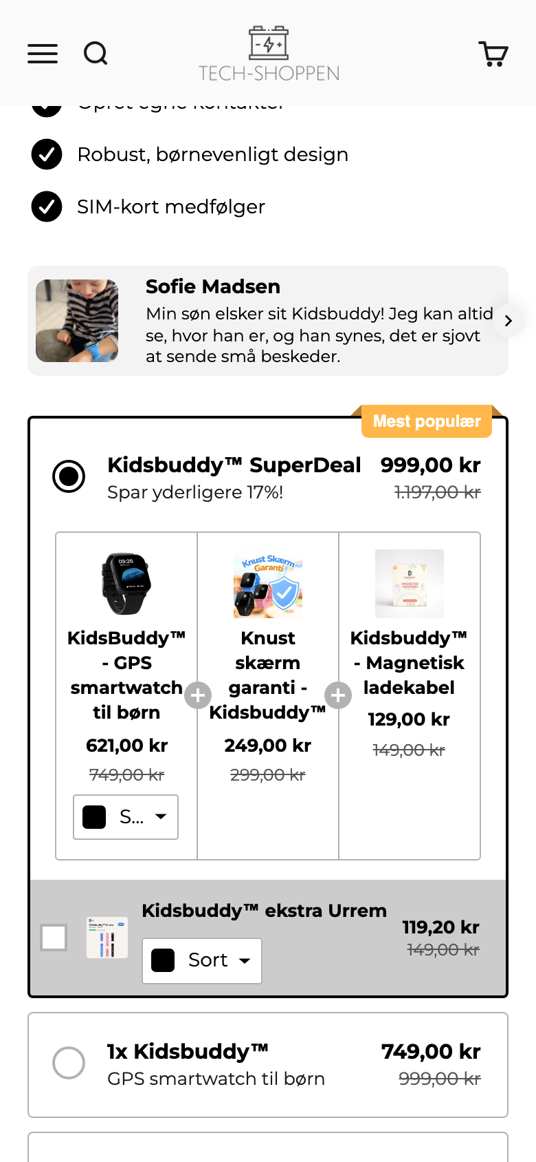
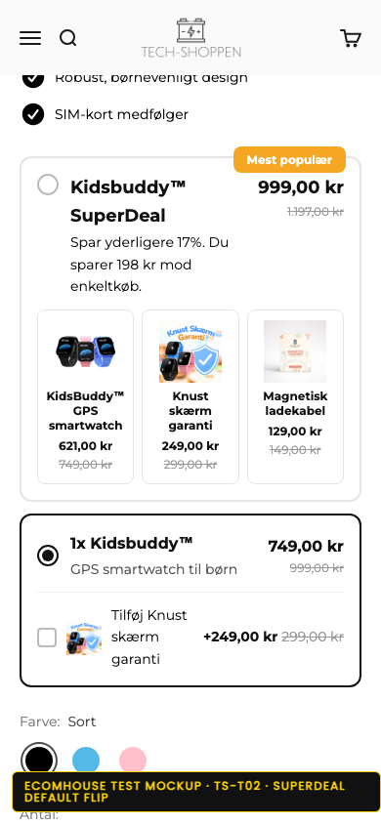
2026
Observation
T02 · Buy box · SuperDeal as a choice, not a surprise
The "SuperDeal" bundle is pre-selected: clicking the plain TILFØJ TIL KURV added 3 items totalling 999 kr when the shopper expected one at 749 kr. Only 51.6% of add-to-carts reach checkout. 1-star reviews cluster on refund friction.
Test ID: TS-T02 Status: In planning
A/B TEST
Hypothesis
CHANGES
If the bundle becomes an explicit opt-in (single item pre-selected, SuperDeal as a visible choice), then cart to checkout rate will rise, because the drawer total matches the price the shopper committed to at the ATC click.
1. Flip the default: "1x Kidsbuddy · 749 kr" pre-selected
2. SuperDeal stays first as the visible upgrade with its "spar 198 kr" saving
3. Guarantee also available as a single checkbox add-on
What we are testing
• Flip the existing radio default: "1x Kidsbuddy · 749 kr" pre-selected
• SuperDeal stays as the visible upgrade choice
• Guarantee (299 kr) also available as a single add-on
Key metrics
1. Cart to checkout rate
2. Revenue per visitor
3. AOV + bundle attach rate (guardrails)
Duration
Device
CONTROL · LIVE BUY BOX
VARIANT · BUILT DESIGN
3 to 4 weeks
All devices
The radio already exists: SuperDeal (999 kr, 3 items) is pre-selected; "1x Kidsbuddy · 749 kr" sits below.
HTML mockup on the live theme. Change spec in the left rail.
Baseline
URL
51.6% cart to checkout · 632 DKK AOV
KidsBuddy buy box + cart drawer
ECOMHOUSE ©ALL RIGHTS RESERVED
32

Slide 34
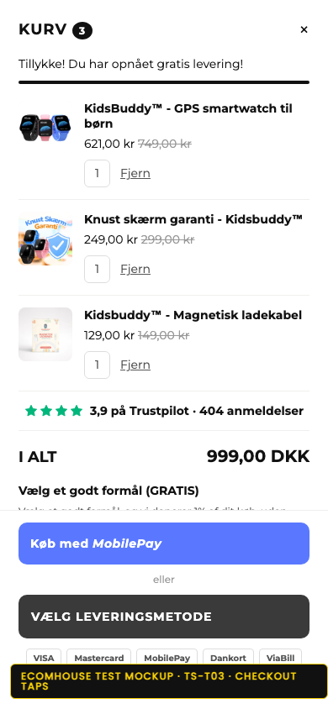
2026
Observation
T03 · Checkout · Two fewer taps on mobile
Mobile checkout completion is 45.3% vs 64.9% on desktop, on a store where 89% of sessions are mobile. The drawer gates its checkout button behind a manual terms checkbox and offers no one-tap express payment before the form.
Test ID: TS-T03 Status: In planning
A/B TEST
Hypothesis
CHANGES
If we remove the drawer-level terms checkbox and surface express payment (MobilePay first) before the form, then mobile checkout completion will rise toward desktop's rate, because the two highest-friction taps on a phone disappear.
1. Terms checkbox removed (acceptance stays in checkout)
2. MobilePay / Shop Pay express row above the CTA
3. Real review count replaces the 5-star claim
What we are testing
• Remove the terms checkbox from the drawer
• Express pay row (MobilePay / Shop Pay) above the CTA
• Real review count replaces the 5-star claim
Key metrics
1. Checkout completion rate (mobile)
2. Overall conversion rate
3. Payment method mix (diagnostic)
Duration
Device
CONTROL · LIVE DRAWER
VARIANT · BUILT DESIGN
3 to 4 weeks
Mobile focus (89%)
A manual terms checkbox gates the checkout button.
HTML mockup on the live theme. Change spec in the left rail.
Baseline
URL
45.3% completion · Est. +170K DKK/q at 55%
Cart drawer + checkout
ECOMHOUSE ©ALL RIGHTS RESERVED
33

Slide 35
2026
07
WHO RUNS THIS
How EcomHouse works
A zero-row CRO service: research, design, build, QA, deploy, test, analysis end to end. The method, and what it has delivered.
ECOMHOUSE ©ALL RIGHTS RESERVED
34

Slide 36
2026
THE ECOMHOUSE METHOD
Six steps, end to end
You approve. We execute. Every step is owned by us, including build, QA, and rollout. Client only approves the brief and rollout.
// 01
// 02
// 03
// 04
// 05
// 06
Research
Ideate
Pre-test brief
Build + QA
Run + monitor
Analyze + roll out
GA4, Shopify, heatmaps, recordings, reviews, support.
→
Hypothesis, variant concepts, copy, Figma prototype.
→
Written brief with metric, confidence, sample size.
→
Shopify or test tool variant, tracked, QA'd across devices.
→
Live test with guardrail watch, weekly progress updates.
→
Written verdict, fee invoiced on rollout to 100 % of traffic.
Zero-row service: the client is not expected to do production work. We handle everything from research through analysis. The client approves the pre-test brief and the rollout decision in writing.
ECOMHOUSE ©ALL RIGHTS RESERVED
35

Slide 37
2026
BRIEF + PROTOCOL
How every test launches and concludes
No test starts without a written, approved brief. Tests only conclude when all approved conditions are met.
PRE-TEST BRIEF
TESTING PROTOCOL
Every test launches with a written, approved brief
Guardrails on tooling, rigor, conclusion
// PART 1 Test setup
// PART 2 Statistical parameters
DEFAULT TOOL
CONFIDENCE
✓
Hypothesis and Control vs Variant difference
✓
Primary metric (RPV or funnel metric)
IntelliGEMS
80 % min
Or Convert, GrowthBook, Shopify-native with written approval.
Higher per test if you require it.
✓
Audience and traffic filters
✓
Statistical confidence (80 % default)
✓
Funnel stage and stage multiplier
✓
Minimum visitor and order count
CONCLUSION
REPORTING
✓
URL targeting
✓
Worked fee range at +5 / +10 / +15 %
All conditions met
Weekly Loom
✓
Frozen baselines from trailing 30 days
✓
Data sources named explicitly
Min visitors, orders, and confidence reached.
Plus a running test log you can access anytime.
ECOMHOUSE ©ALL RIGHTS RESERVED
36

Slide 38
2026
COMPENSATION
We win when you win
Performance-based fee on every winning test rolled out to 100 % of traffic. One-time charge per test. No attribution window. No recurring tail.
// PERFORMANCE FEE
// OPTIONAL RETAINER
% of estimated monthly revenue uplift
Fixed monthly fee
Y %
X kr / month
Charged once per winning test on rollout. Calculated from the test's measured uplift and the client's own data, with the agreed stage multiplier applied.
Optional. Predictable monthly cost on top of (or instead of) the performance fee. Some clients prefer this for budgeting.
→
One time fee per winning test
→
Billed on the 1st, in advance
→
No recurring tail, no attribution window
→
Void if not agreed
→
Loser and inconclusive tests are free
→
Stackable with the performance fee
Billing: one invoice on the 1st covering the retainer (if any) plus the performance fee for every winning test rolled out last month. 8 day payment terms. Third-party costs (test tools, apps) paid by the client.
ECOMHOUSE ©ALL RIGHTS RESERVED
37

Slide 39
2026
SCHEDULE A · STAGE MULTIPLIERS
Tests further from purchase carry more projection risk
The stage multiplier discounts the performance fee for upper-funnel tests where impact is estimated rather than measured.
100 %
RPV · AOV · Purchase CVR · Checkout CVR
Revenue measured directly by the testing software.
75 %
Cart to checkout · PDP add to cart
One step from purchase. Light projection of downstream behavior.
50 %
Collection to PDP · PDP engagement
Two steps from purchase. Multiple downstream rates to project.
25 %
Homepage to collection · Navigation · Search
Three or more steps from purchase. Heaviest projection assumptions.
Only your own data goes into the estimate. No industry benchmarks. Visitors, baseline CVRs and AOV are pulled from the trailing 30 days of GA4 and Shopify, frozen pre-test, and approved by you.
ECOMHOUSE ©ALL RIGHTS RESERVED
38

Slide 40
2026
TRACK RECORD
Three winning EcomHouse tests
Real results from EcomHouse client engagements. Each test rolled out to 100 % of traffic after meeting the pre-approved confidence threshold. IntelliGEMS test tool.
Comforth · DK
PH Import · DK
PH Import · DK
Product tags on collection cards
PDP volume discount tiers
Homepage hero optimization
PROFIT / VISITOR
CONVERSION RATE
REVENUE / VISITOR
+11,42%
+11,08%
+20,87%
-11 % to +39 %
-3 % to +27 %
-12 % to +67 %
+106.550 kr / mo
+134.917 kr / mo (RPV)
+272.913 kr / mo
CR
+13,07%
2,09% → 2,37%
RPV
+17,10%
20,36 → 23,84 kr
CR
+7,72%
16,3% → 17,6%
RPV
+11,13%
26,88 → 29,87 kr
AOV
+5,42%
293,47 → 309,37 kr
AOV
+12,21%
401,87 → 450,94 kr
Orders / mo
+169
Orders / mo
+298
PDP view rate
+9,21%
56,6% → 61,8%
Added trust + benefit tags to collection product cards. Lift compounded across all three metrics.
Surfaced volume discount tiers directly on the PDP. CR was primary, RPV and AOV lifted simultaneously.
Reworked homepage hero with lighter background. Lifted the full funnel: more PDP views, higher AOV, more revenue.
Source: IntelliGEMS test reports. Confidence intervals shown reflect range of likely true effect. References available on request.
ECOMHOUSE ©ALL RIGHTS RESERVED
39

Slide 41
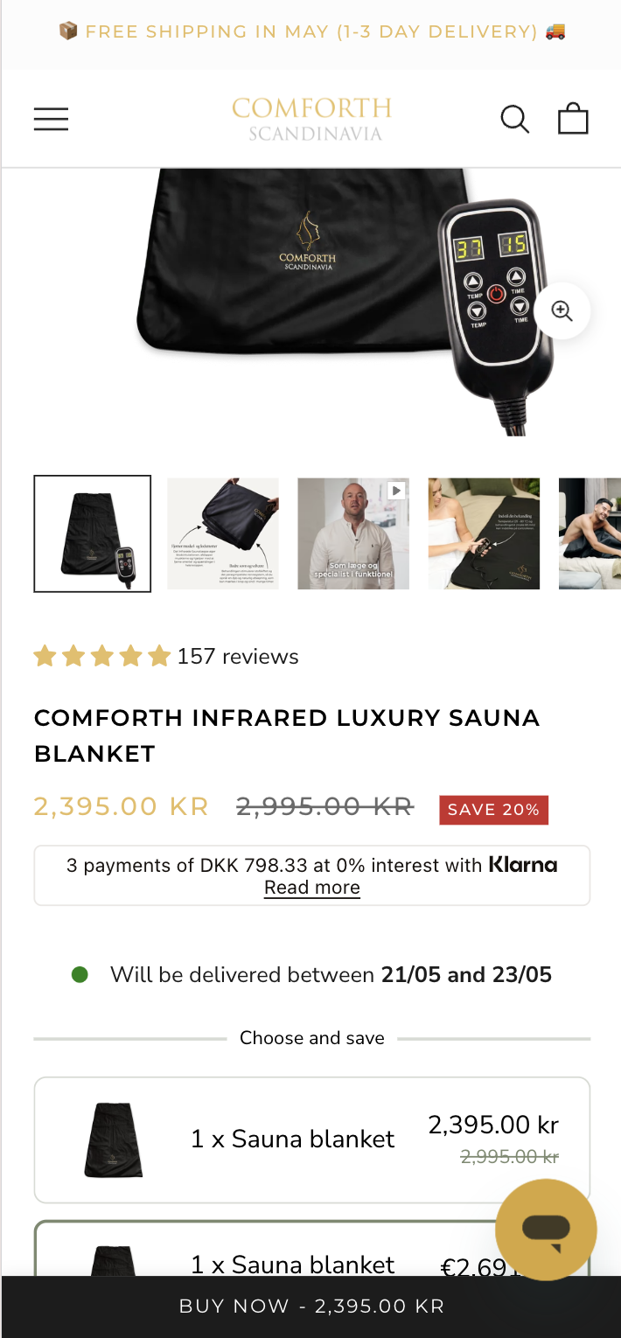
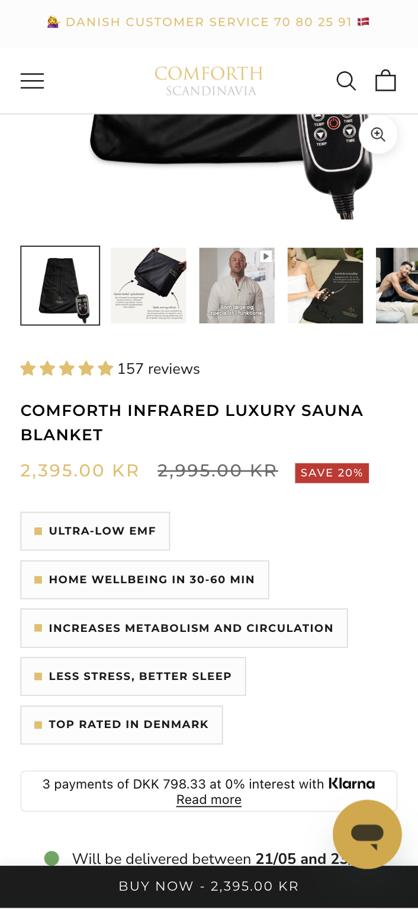
2026
CASE STUDY · 01
Comforth · Product tags on collection cards
Added benefit and trust tags directly to product cards on collection pages. Variant lifted all three commercial metrics with no degradation in any guardrail. IntelliGEMS, 100 % rollout.
PROFIT PER VISITOR (PRIMARY)
+11,42%
-11 % to +39 % CI
+106.550 kr / month projected
METRIC
CONTROL
VARIANT
Δ
Conversion rate
2,09 %
2,37 %
+13,07%
Revenue / visitor
26,88 kr
29,87 kr
+11,13%
Profit / visitor
15,07 kr
16,80 kr
+11,42%
CONTROL
VARIANT
Est. orders / mo
·
+169
ECOMHOUSE ©ALL RIGHTS RESERVED
40

Slide 42
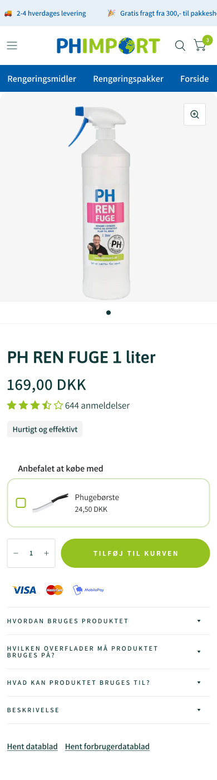
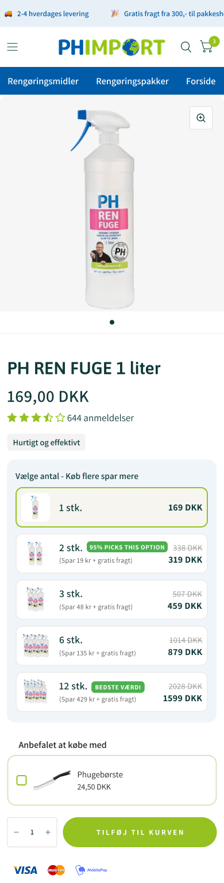
2026
CASE STUDY · 02
PH Import · PDP volume discount tiers
Surfaced volume discount tiers directly on the PDP. The variant lifted purchase rate, AOV, and downstream profit simultaneously. IntelliGEMS, 100 % rollout.
CONVERSION RATE (PRIMARY)
+11,08%
-3 % to +27 % CI
+298 orders / month · +134.917 kr / mo (RPV)
METRIC
CONTROL
VARIANT
Δ
Conversion rate
6,94 %
7,71 %
+11,08%
Revenue / visitor
20,36 kr
23,84 kr
+17,10%
Profit / visitor
10,49 kr
12,25 kr
+16,68%
CONTROL
VARIANT
Avg order value
293,47 kr
309,37 kr
+5,42%
ECOMHOUSE ©ALL RIGHTS RESERVED
41

Slide 43
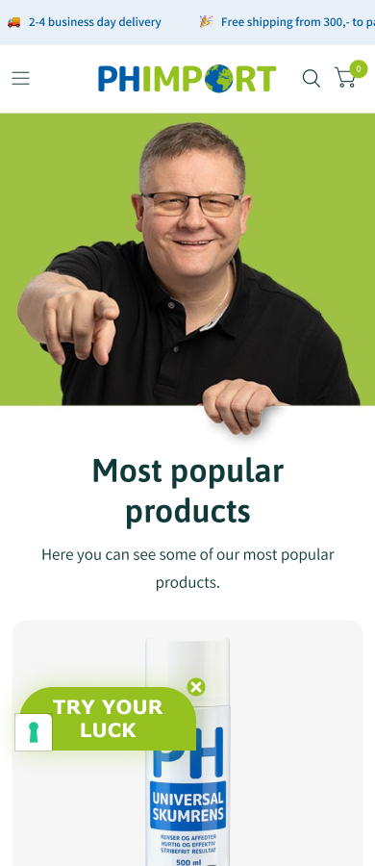
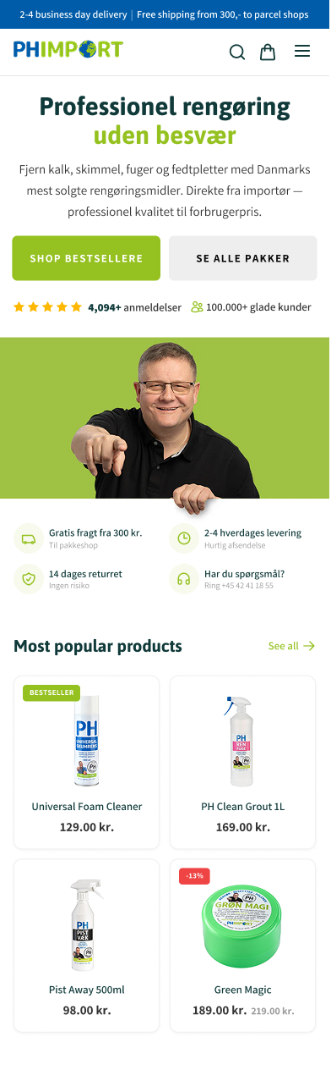
2026
CASE STUDY · 03
PH Import · Homepage hero optimization
Reworked homepage hero with a lighter background and a sharper category-led layout. Lift compounded through PDP views, AOV, and revenue. IntelliGEMS, 100 % rollout.
REVENUE PER VISITOR (PRIMARY)
+20,87%
-12 % to +67 % CI
+251 orders / month · +272.913 kr / mo
METRIC
CONTROL
VARIANT
Δ
Revenue / visitor
65,50 kr
79,17 kr
+20,87%
Profit / visitor
34,78 kr
42,35 kr
+21,78%
Avg order value
401,87 kr
450,94 kr
+12,21%
CONTROL
VARIANT
PDP view rate
56,6 %
61,8 %
+9,21%
ECOMHOUSE ©ALL RIGHTS RESERVED
42

Slide 44
2026
NEXT STEP
Unbreak the data,
answer the doubt, and win the add-to-cart.
92.8% of product viewers leave before adding to cart, and a third of orders are invisible to the channels that bought them. Phase 1 (attribution repair, proof at the buy box, Clarity installed) carries no downside and can ship in three weeks.
Conservative target: Est. 250,000 to 400,000 DKK per quarter from the two funnel fixes alone.
Prepared by EcomHouse
ECOMHOUSE ©ALL RIGHTS RESERVED
43

